Slide 1
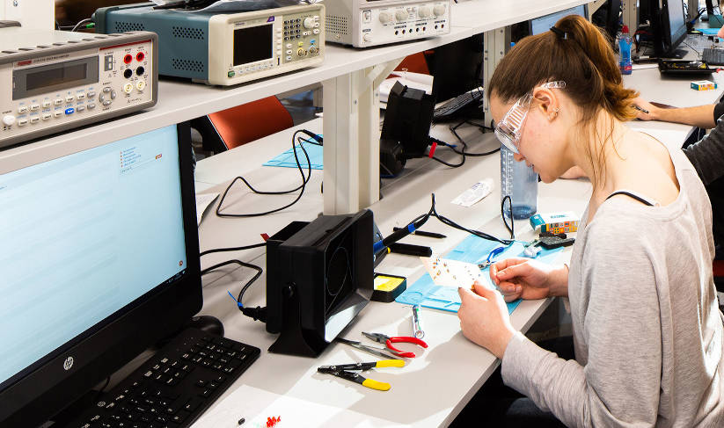
Remote Electronics Laboratories
Jack Renshaw (z5114675) UG Thesis 2021/22

Slide 2
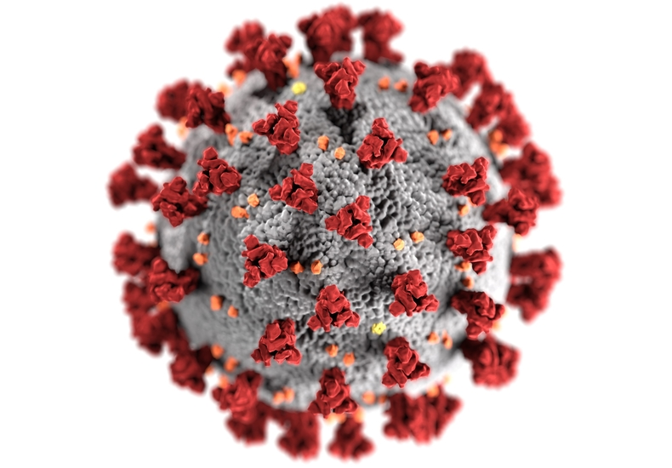
Context
Move towards remote education
Institutional Incentives
Student-Driven
HD Video Streaming, Conference Calls, Lecture Recordings
COVID-19 Accelerated the trend

Slide 3
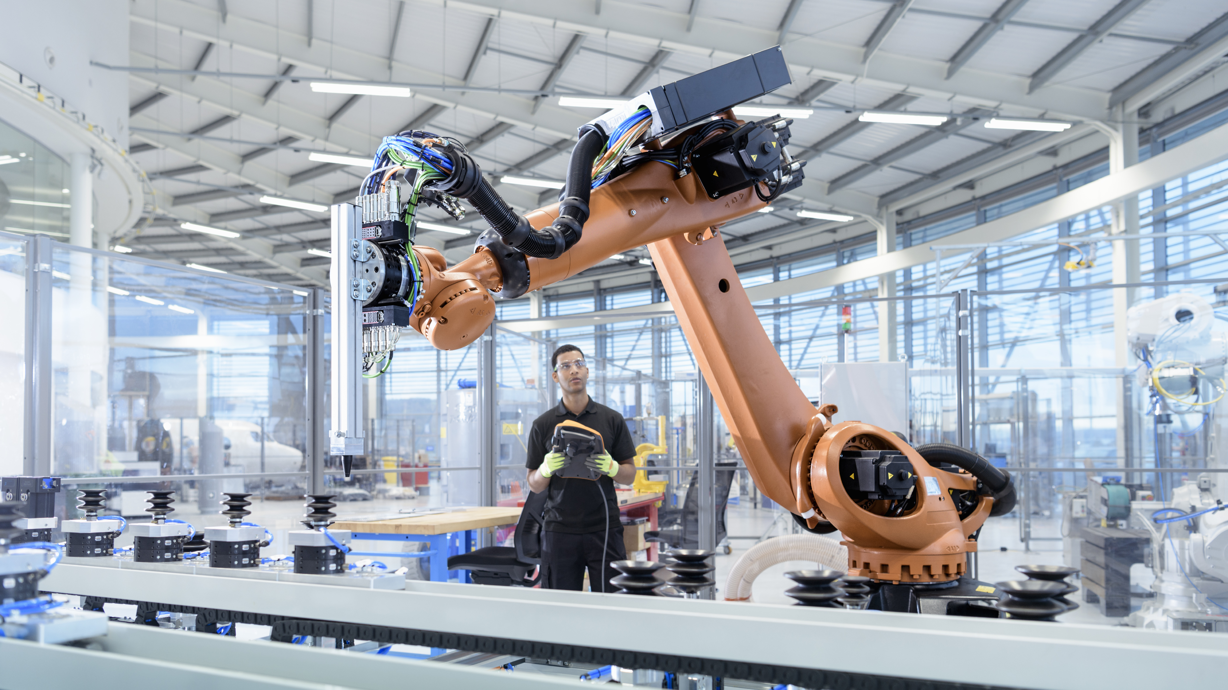
Purpose of Laboratories

Slide 4
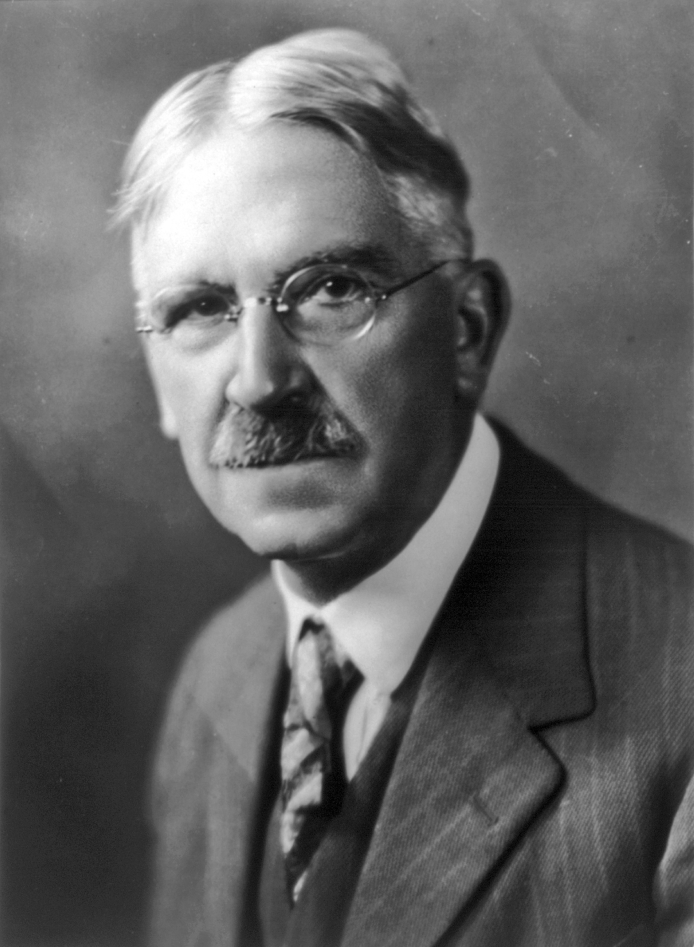
The Pedagogy of Electrical Engineering
1. Engineering as a vocational degree
2. ‘Learning By Doing’
3. The centrality of Design
4. Imparting practical skills in addition to theoretical knowledge
American Philosopher and Educator John Dewey
https://www.teaching.unsw.edu.au/assessing-laboratory-learning

Slide 5
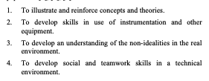
Laboratories within Electronics Engineering
Objectives include “gaining a deeper understanding of abstract concepts and theories gained by experiencing and visualising them as authentic phenomena”
UNSW Teaching – Assessing Laboratory Learning. Accessed 30th Oct 2021
Ingvar Gustavsson, Kristian Nilsson, and Thomas Lagö. 2009. On physical experiments and individual assessment of laboratory work in engineering education. In Proceedings of the International Conference on Management of Emergent Digital EcoSystems (MEDES '09).
Association for Computing Machinery, New York, NY, USA, Article 84, 506–509. DOI:https://doi.org/10.1145/1643823.1643926

Slide 6
A Concrete Example – Lab 1 ELEC2133
Theory and Background
1. Lab investigates non-idealities of OPAMPs (LM301A)
A. Measuring propagation delay, slew rate, bandwidth
B. Investigating the effects of an (external) compensation capacitor on the above
The lab problematizes ideal OPAMPs by introducing real world effects Teaches students a theoretical framework for understanding the non-ideal aspects of OPAMPs Introduces a practical method for overcoming limitations (cap compensation)

Slide 7
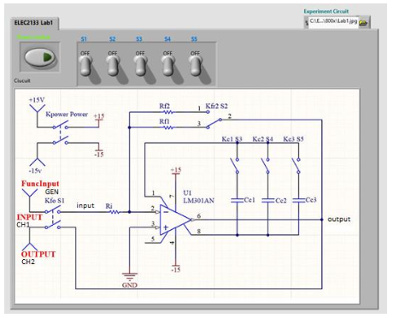
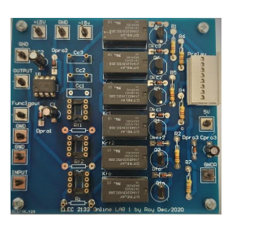


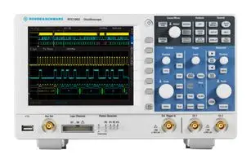
A Concrete Example – Lab 1 ELEC2133
Lab Operation
LabVIEW Interface
Lab Computer
Circuit Change
Switch Instruction
Schematic View
Settings Configuration
Oscilloscope (IP Access)
Oscilloscope Reading
Signal Output
Lab PCB

Slide 8
A Concrete Example – Lab 1 ELEC2133
Shortcomings
Circuit Schematic is simply presented to students
Schematic (vs. breadboard) view
Idealized sources (as opposed to sig-gen and PS)
Lab can be “brute forced” due to finite switches

Slide 9
Thesis Aims
Thesis Aims
To develop an intuitive web-based interface that enables students to build, validate and simulate basic electronic circuits. The interface should allow the student to build and simulate circuits in either a schematic or breadboard representation.
To develop a method for implementing student circuits designed using (1) physically via the existing LabVIEW framework, or with some other framework that can be integrated into the existing prefabricated PCB’s used within the context of ELEC1111, ELEC2133 and ELEC3106 Laboratories
To combine the two above objectives into a single platform that can be customised, managed and modified as needed by course coordinators and lab demonstrators
From the Thesis Aims Section of a draft of the Preliminary Thesis Report
Reach goals:
To allow students to export their designs in a format compatible with SPICE for further analysis
To include in the design a platform that allows lab demonstrators to examine and verify student designs.
To make the design sufficiently general such that is can be implemented by other universities with disparate course designs, and used as a general online circuit builder and simulator
To allow students to overlay simulated and experimental scope readings in order to compare and contrast theoretical and empirical results.

Slide 10

Current Solutions in Academic Literature
Jack Renshaw (z5114675) UG Thesis 2021/22

Slide 11
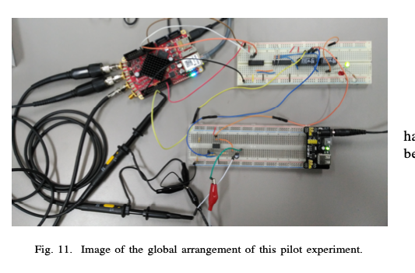
RedPitaya
Remote laboratory experiments of Analog Electronics based on ’RedPitaya’ Garcia-Orellana et al, University of Extremadura, Spain
The RedPitaya is a “Complete Package” design comprised of 3 main components on a single device. This is good example of a class of solutions to remote labs
1. Web Interface – “a file programmed in HTML and JavaScript with JQuery, which the NGINX web server [hosted on the device] sends to the client”
2. Controller – “A set of C-Programmed functions which is loaded by the web server when any communication is required [with the FGPA]
3. Hardware – The core of the device is the RedPitaya device, which contains 16 digital IO pins, ADCs, an FPGA, LED’s. Arduino on steroids.

Slide 12



RedPitaya
Remote laboratory experiments of Analog Electronics based on ’RedPitaya’ Garcia-Orellana et al, University of Extremadura, Spain
Low Cost, Reasonably Adaptable and Configurable
1. Web Interface – “a file programmed in HTML and JavaScript with jQuery, which the NGINX web server [hosted on the device] sends to the client”
2. Controller – “A set of C-Programmed functions which is loaded by the web server when any communication is required [with the FGPA]”
3. Hardware – The core of the device is the RedPitaya device, which contains 16 digital IO pins, ADCs, an FPGA, LED’s. Arduino on steroids.
Design

Slide 13
RedPitaya
Remote laboratory experiments of Analog Electronics based on ’RedPitaya’ Garcia-Orellana et al, University of Extremadura, Spain
Hardware Concern
Does the device have the ability to measure signals up to and above the slew rate of OPAMPs?
With 8 decimal points, the sampling rate of the RedPitaya is 5.6MS/s. RTM3004 is 2.5GS/s
What are the limitations on signal generation and current?
absolute max output current is 16mA. Is this enough? We will likely need a separate supply/siggen.
Pedagogical Concern
The system out of the box doesn’t incorporate design, simply measurement and switching. The system is adaptable, so there’s scope to add this retroactively
Oscilloscope
Practical Concern
Setting up each circuit before each lab will be highly cumbersome
if the circuit is complicated. This is something STUDENTS should be doing!
It would be difficult to integrate this into the existing PCBs in an effective way
https://redpitaya.readthedocs.io/en/latest/appsFeatures/examples/acqRF-samp-and-dec.html
https://www.farnell.com/datasheets/3216075.pdf

Slide 14

Preliminary Work and Design
Jack Renshaw (z5114675) UG Thesis 2021/22

Slide 15









Preliminary Work
Remote laboratory experiments of Analog Electronics based on ’RedPitaya’ Garcia-Orellana et al, University of Extremadura, Spain

Slide 16






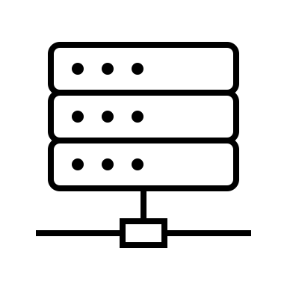
High Level Design
Separate Server Approach
Lab Computer
Power Supply/Sig Gen
Student
Power + Signal
In Person lab demonstrator interaction
LabVIEW Command
Circuit (Plant)
Oscilloscope/Web Cam feedback
Signal
Scope Reading
Interactive Circuit Building Simulation and Application Commands
Translated + Validated
Actuation Command
Oscilloscope
Web Server

Slide 17
High Level Design
Separate Server Approach
Web Server
Lab Computer
Student
Serves an HTML page to the student that allows circuit design, simulation and application
Relays oscilloscope, webcam and lab demo interactions to student
Connects to Web Server to:
Design and Simulate the circuit
Apply the designed circuit to the plant
Receives Oscilloscope readings from IP-connected digital oscilloscope
Receives and authenticates student requests to save, simulate and apply
Receives application requests from the Web Server, translate and applies these to LabView instructions
Performs circuit analysis using NGSpice Command Line tool
Connects to Lab Computer to:
Interact with Lab Demos
See the circuit via the Web Cam
View the Oscilloscope
Validates student circuit, electrically and in terms of its validity as a lab solution
Relays application requests to the Lab Computer

Slide 18
Process Flow
From Course Coordinator/ Lab Demo and Student Perspectives
Configure Authentication, Components, Labs, Other Settings
Define “Correct Solutions” to each lab
Install the program on each lab computer
User Authentication
User => Server => Lab Computer association on a per-session basis (flexibility)
Student is served the design web page.

Slide 19

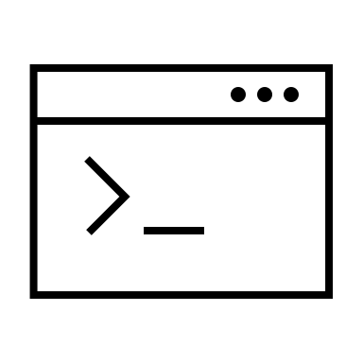

High Level Design
Separate Server Approach
User Interface
Circuit Simulation
Integration
Circuit Application
1. Transform a student design into an NGSpice circuit
Validate a student design in terms of an acceptable solution to the practical experiment
Display the relayed SPICE data within the UI scope
Call Spice from the command line and relay the response to the student
Transmit student designs to the lab computer upon student request
Translate the student design into LABView instructions
Authentication
Lab Computer Association
Execute LabVIEW Instructions
Requests, Responses, Timing
?Integrate Oscilloscope and Simulation

Slide 20
Thesis Plan
Jack Renshaw (z5114675) UG Thesis 2021/22

